Slide 1
Multivariate N-BEATS forecast
Yan Sun, Yezhou Sun
sun.yan11@merck.com

Slide 2
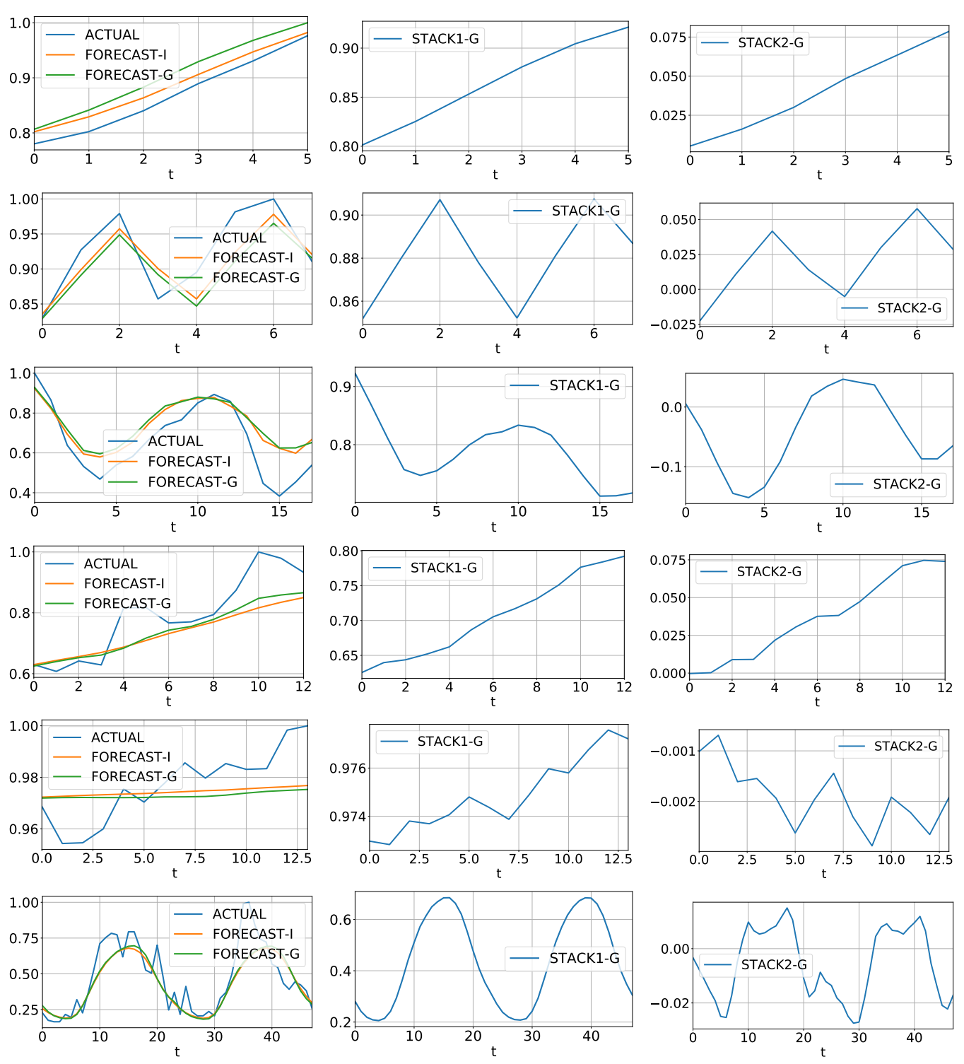
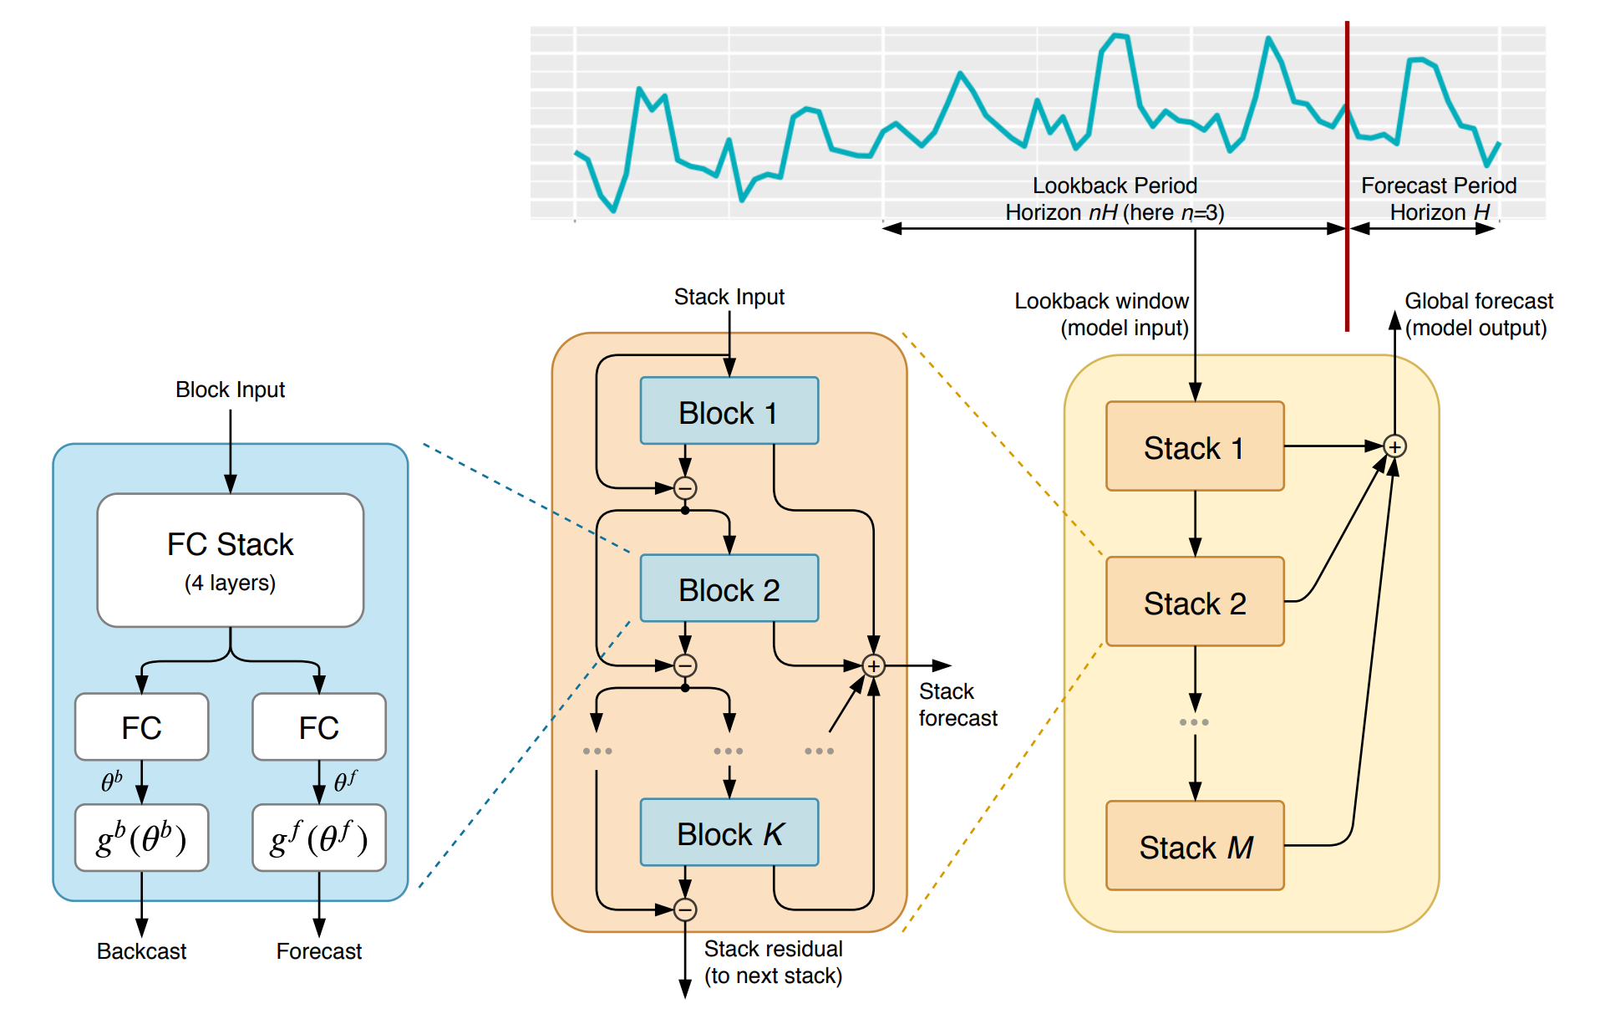
Introduction of N-BEATS
N-BEATS model has become popular for explainable forecast
N-BEATS uses a multi-layer residual network to capture the trend and seasonality within each stack, and generates a Backcast and forecast each time.
NOT
interpretable!

Slide 3
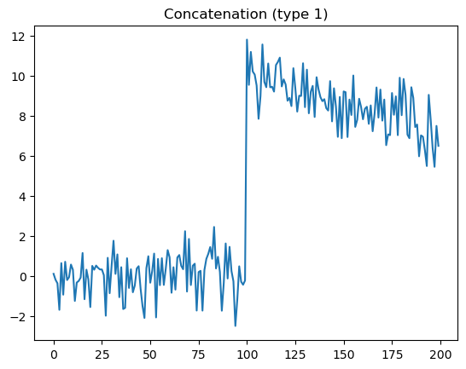
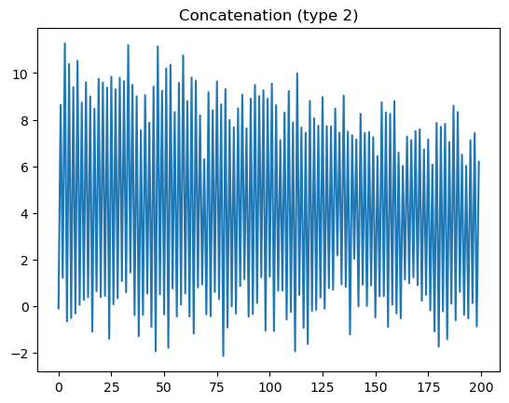
Current drawbacks
N-BEATS does not produce interpretable results in multivariate time series forecast (tensors have to be flattened to 1-dimensional through concatenation)
It is of interest to predict certain series given the historical data of multiple series, while still utilizing the interpretability of N-BEATS.

Slide 4
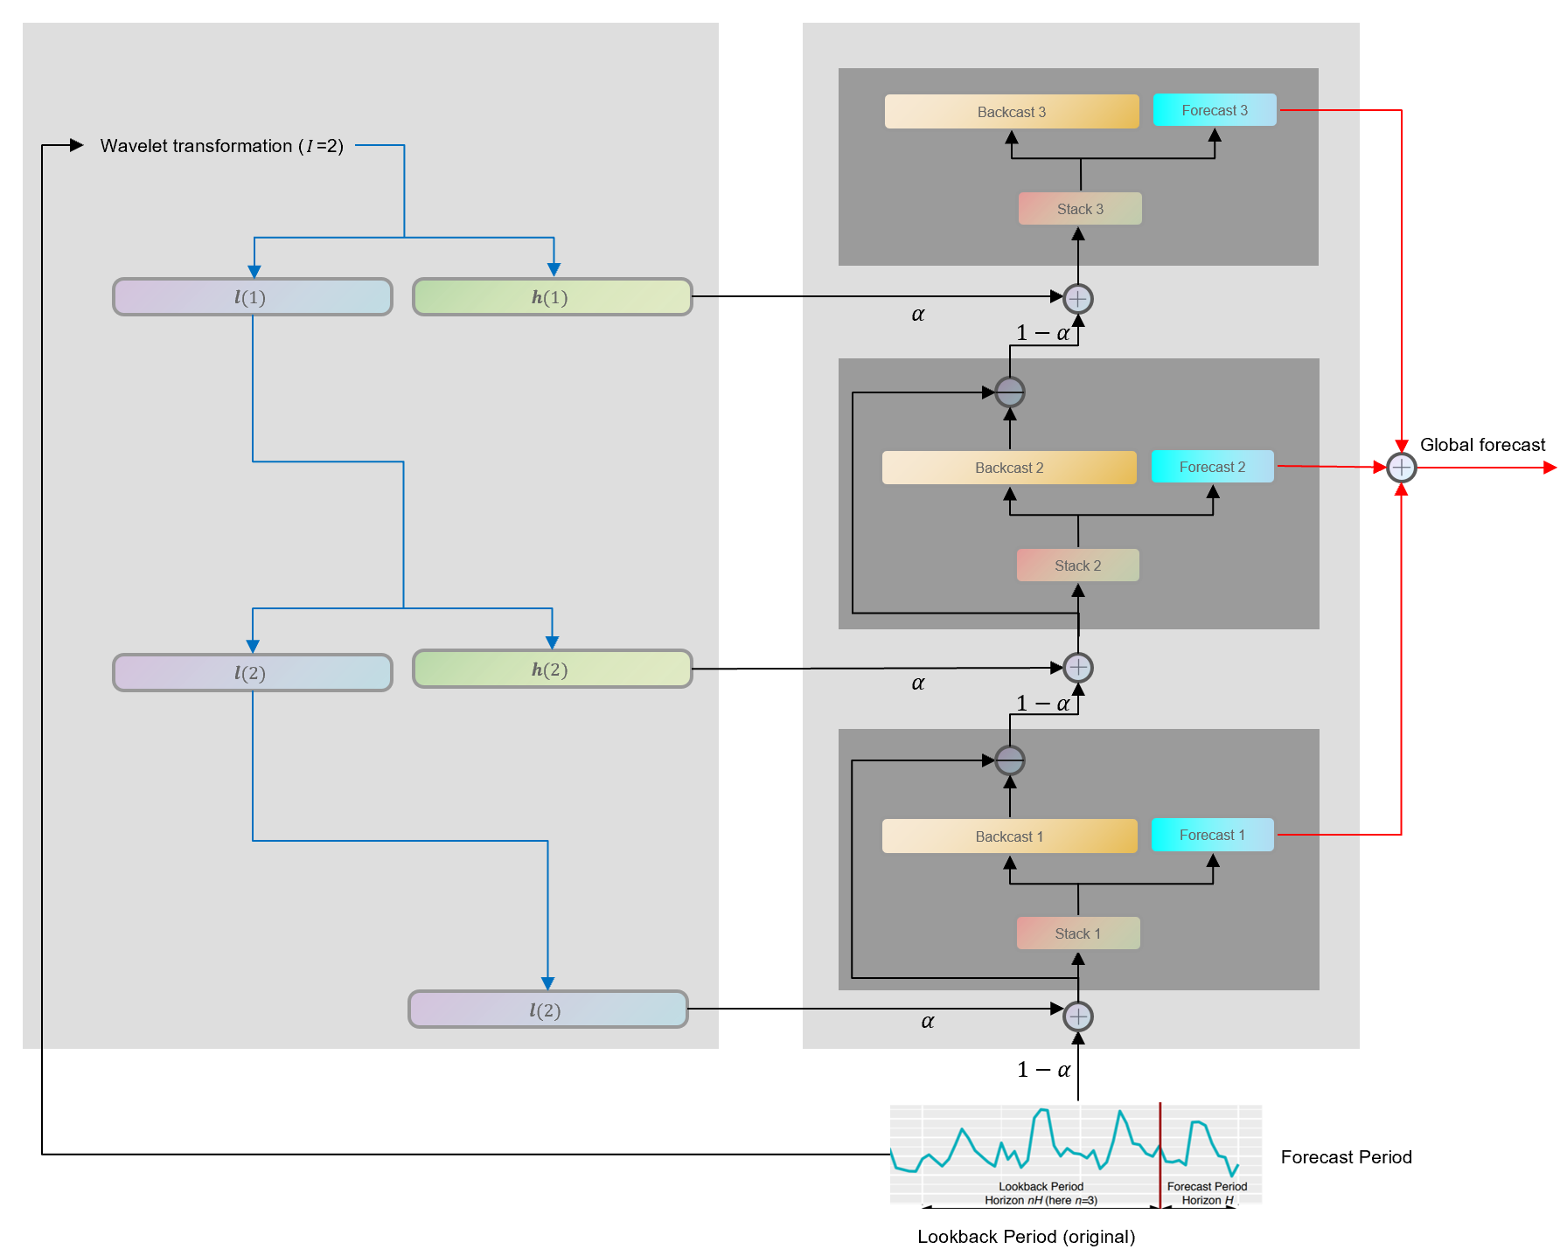
Proposed idea
In N-BEATS model, when the input series is too long, it cannot capture high-frequency patterns in lower stacks. Therefore, we need to ‘inform’ it with certain temporal patterns.
Within each stack of input, we enhance the input signal through a Fourier filtering. Stacks with higher index will deal with higher frequency patterns by incorporating a higher frequency Fourier subseries.

Slide 5
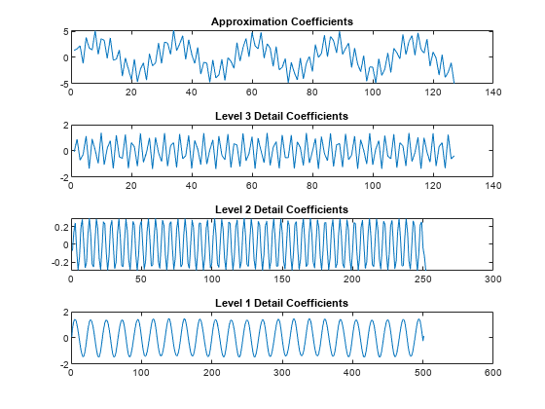
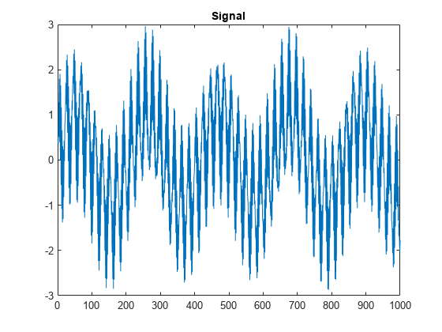

Why it works?
Intuitively, when $α$ is close to 1, the inputs to each stack will be decoupled, with different stacks learning different frequency patterns. In this way each layer has its own ‘target’ function and will try to approximate this function. Therefore, the outputs of each stack will still be interpretable.

Slide 6
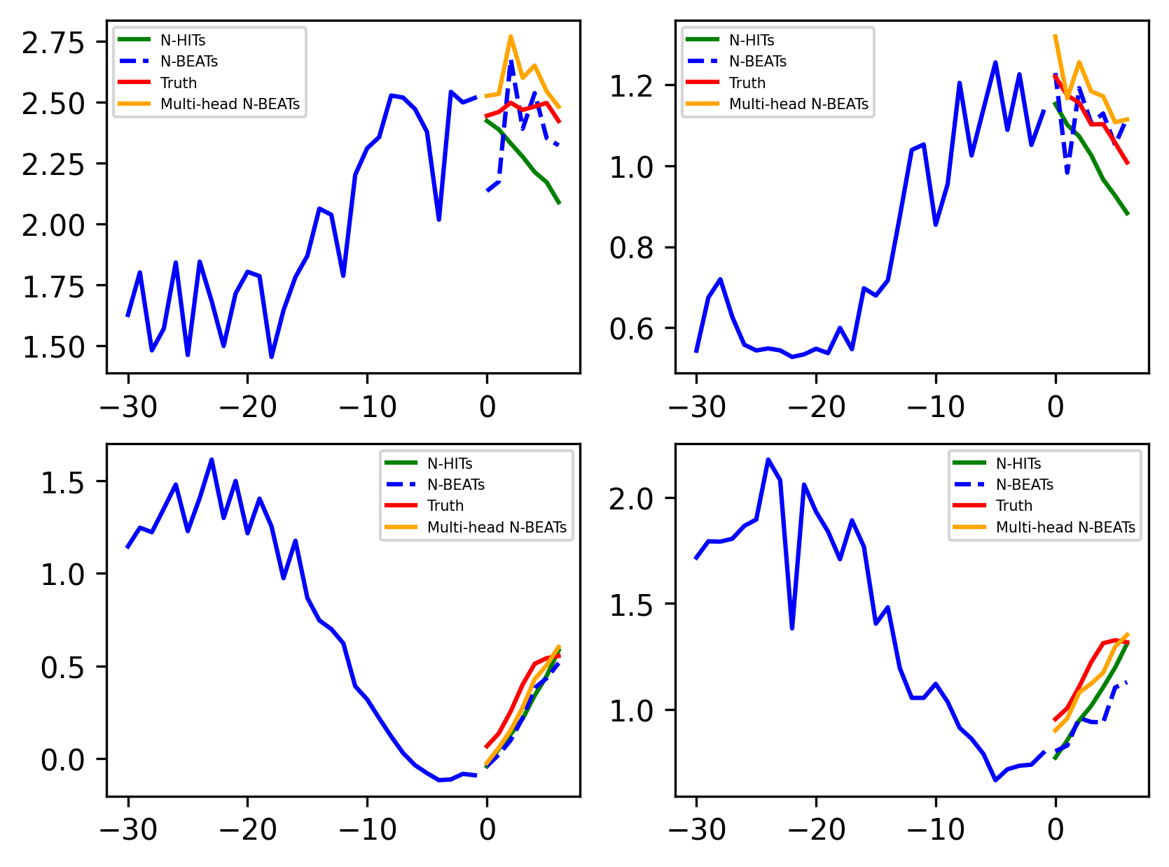
Experiment
Data preparation: multi-variate time series with temporal laggings for simulated data based on stocks data
Stocks data very popular in multivariate forecasting
We use timeGAN to further increase the sample size
Results
We forecast a univariate time series given the history value of multivariate series.
Our method shows competitive performance is predicting time series.

Slide 7
Future work
Test multiple datasets using our method
Ablation studies on the effects of Fourier infusion.

